Slide 1

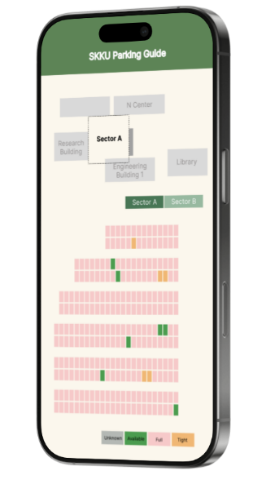
SKKU Parking Guide
Final presentation
캡스톤프로젝트 Team I-dle
김세헌
김형진
노하연
박인찬

Slide 2





Contents
1
2
3
4
5
Motivation
&
Objective
Project
Progress
&
Role of Team Members
Final Design
&
Challenges
Demonstration
Results

Slide 3
Motivation & Objective
60%
90%
Drivers Stressed by Parking
Drivers wasting time on Parking

Slide 4
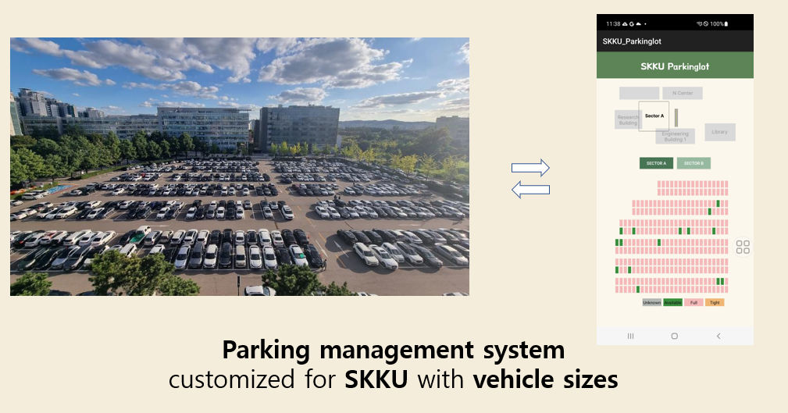
Motivation & Objective

Slide 5
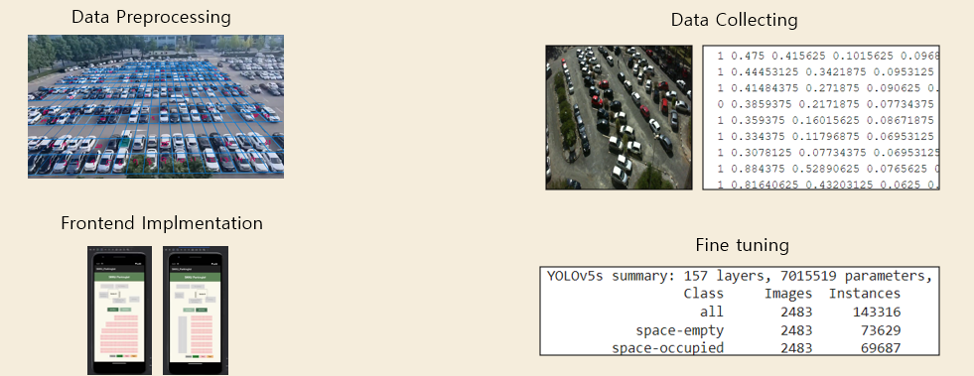
Project Progress
Week
3 4 5 6

Slide 6
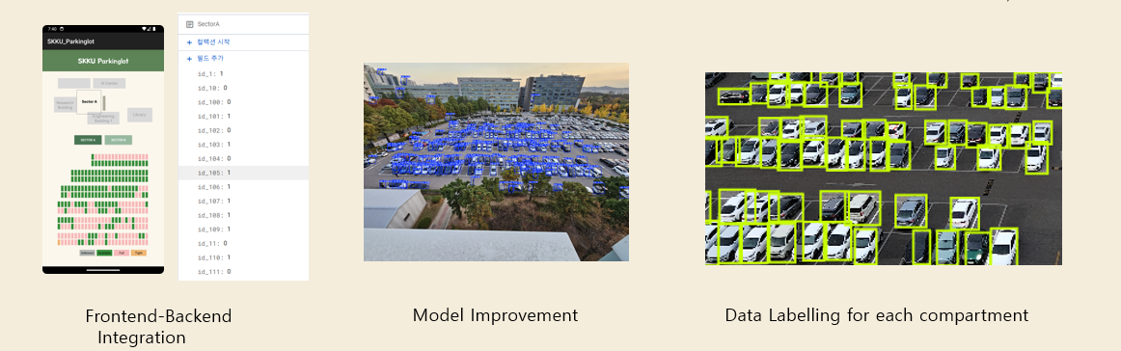
Project Progress
Week
7 8 9 10

Slide 7
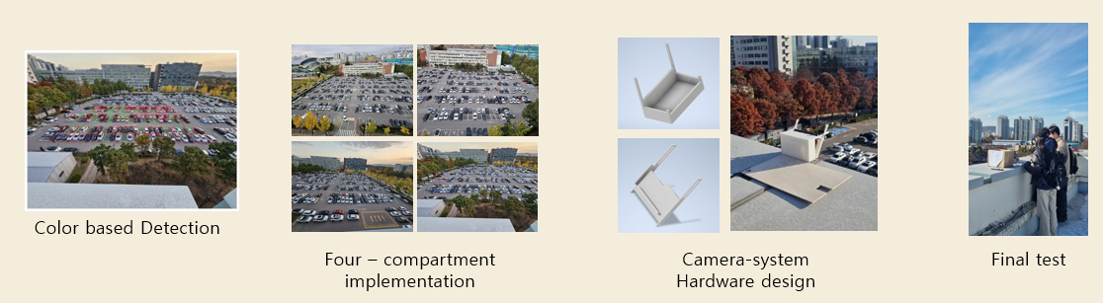
Project Progress
Week
11 12 13 14

Slide 8
Kim Seheon
Role of Team Member
Team Leader
Kim Hyeongjin
Parking Spot Coordinates Labeling
Model Implement
Front-end Development
Database Application Design
Camera-system Hardware Design
Noh Hayeon
Park Inchan
Vision Processing
Data Preprocessing
Model Implement
Vision Processing
Data Preprocessing
Model Implement

Slide 9

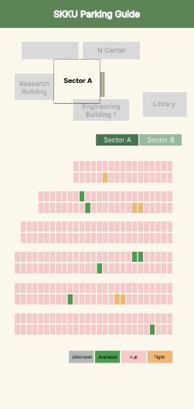
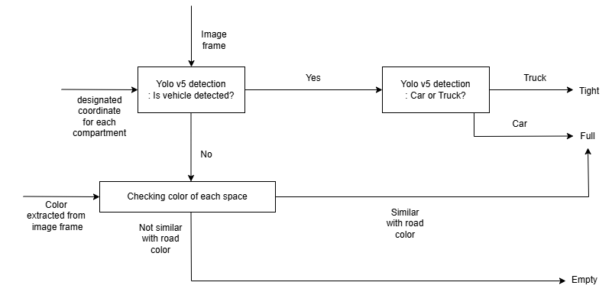
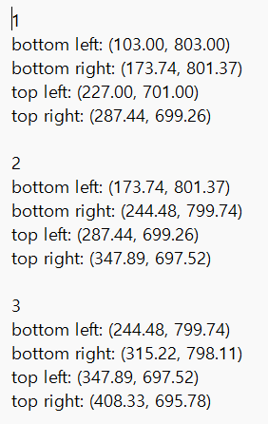
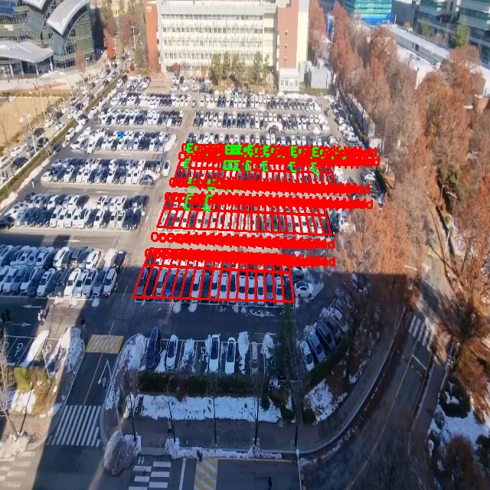
Final Design
< Input >
Sector A~D
<Algorithms>
<Application>
database

Slide 10
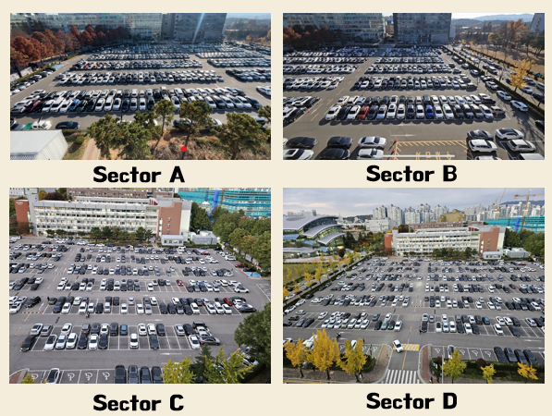
Final Design - Inputs
Real-Time Captures
Preprocessed Coordinates

Slide 11
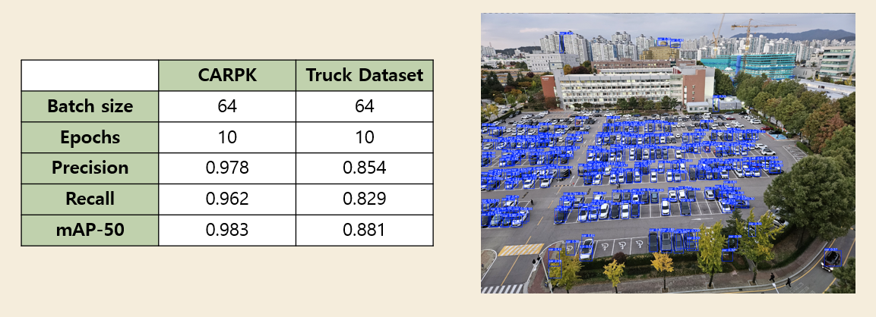
Final Design - Main Algorithms
1. Car, Truck detection by fine-tuning YOLOv5 model

Slide 12
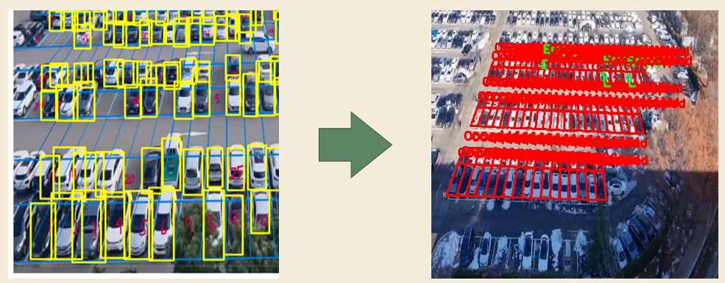
Final Design - Main Algorithms
2. Matching Cars with Parking Lot Spots
Yellow: detected car
Blue: parking lot spaces
Send this data {slot_id: stauts}
to database

Slide 13
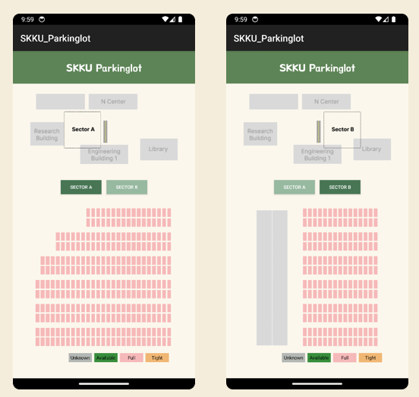
Final Design - App Implementation
Color | Status
Grey | Unknown (not visible)
Green | Available (empty)
Pink | Full (occupied)
Orange | Tight (narrow space)

Slide 14
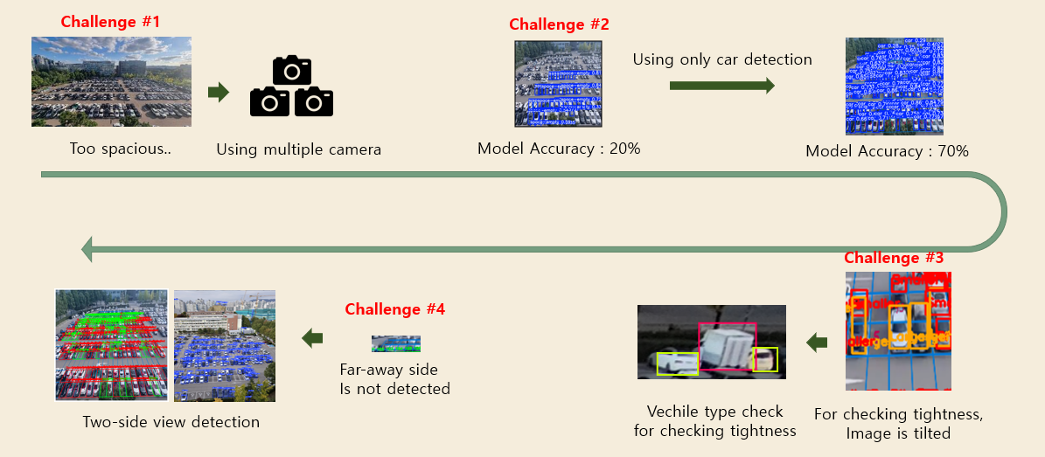
Challenges (1)

Slide 15
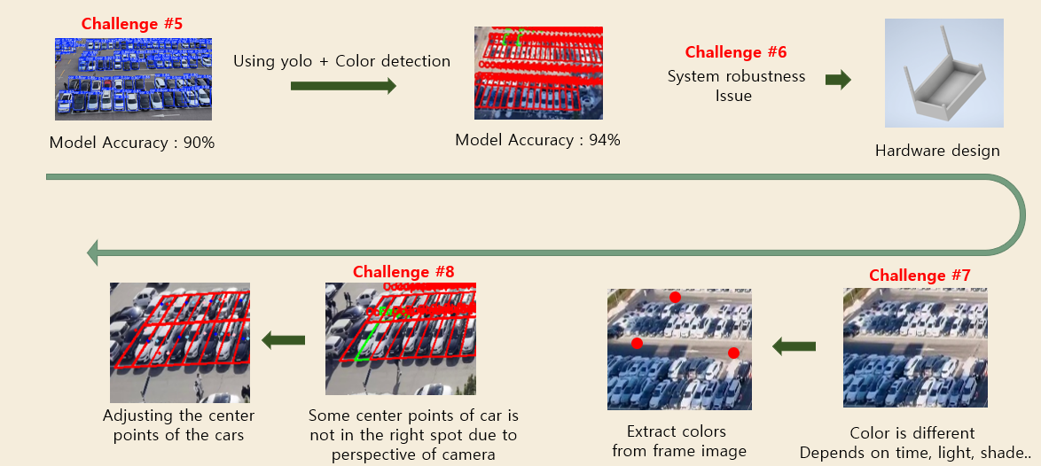
Challenges (2)

Slide 16
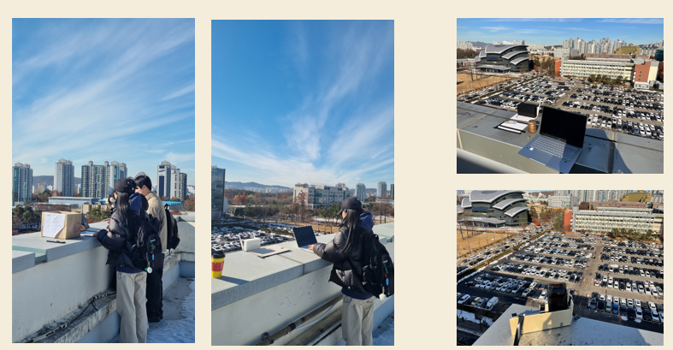
Demonstration
<Pharmetueical Building,
Sector C>
<Pharmaceutical Building,
Sector D>
<Engineering Building,
Sector A>
<Engineering Building,
Sector B>

Slide 17
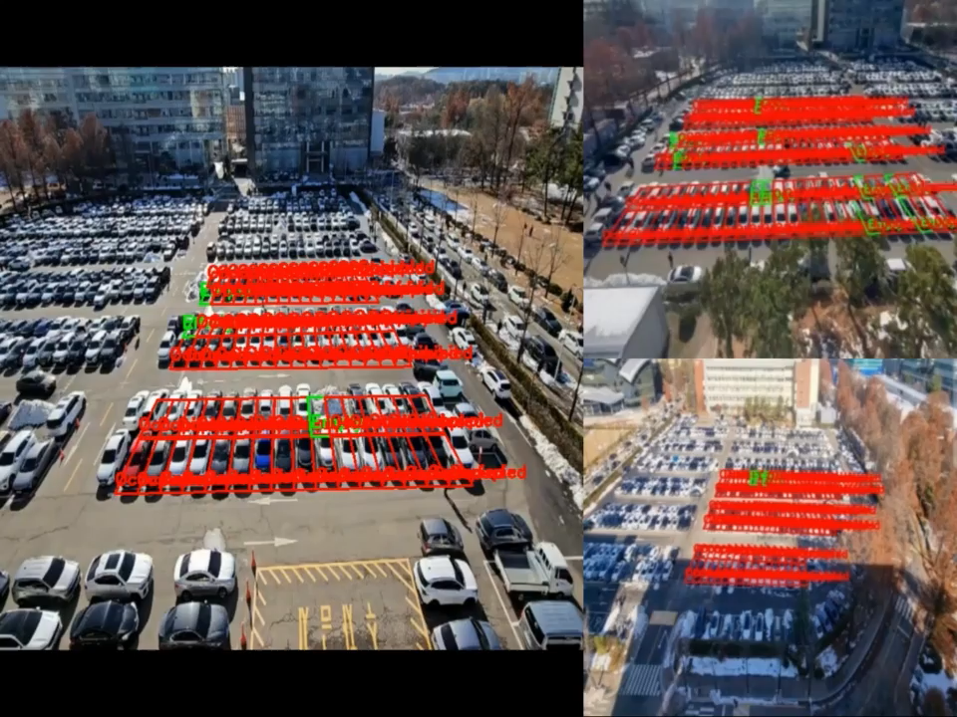
Demonstration

Slide 18
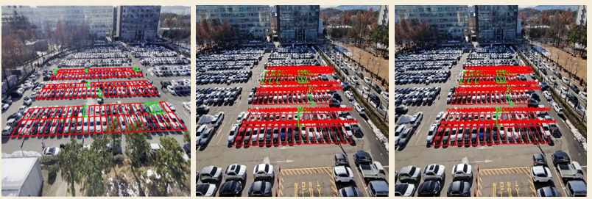
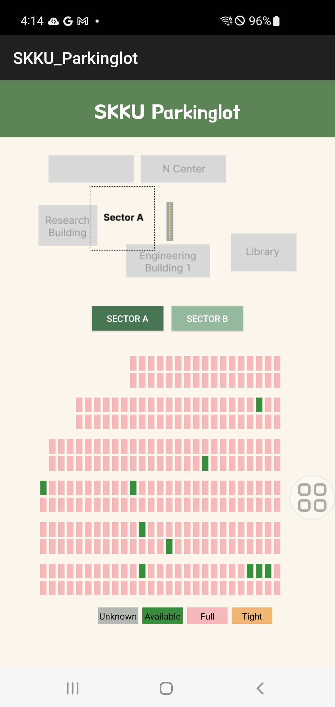
Results – Evaluation & Metrics
 | Car | Empty
Accuracy | 0.9601 | 0.9601
Precision | 0.9921 | 0.3500
Recall | 0.9667 | 0.7000
Precision
= real empty space / prediction of empty space
= 7 / 20
= 0.35

Slide 19
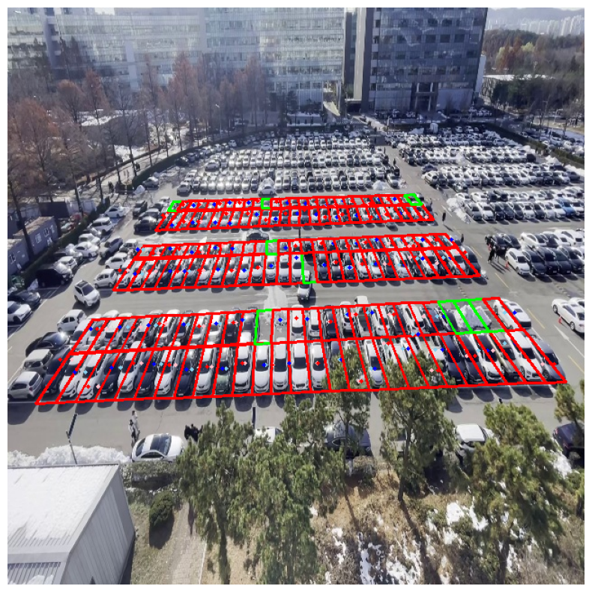
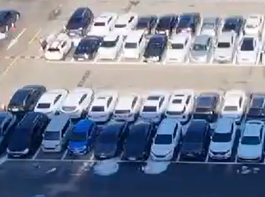
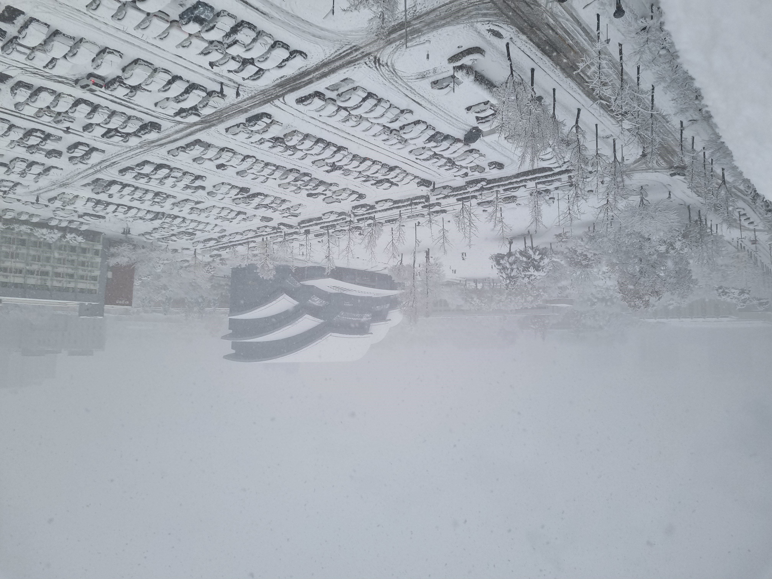
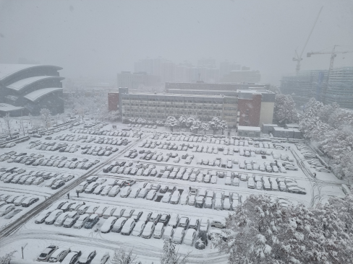
Results - Limitation
Some color of the car
Can be similar with road
Unpredicted object
Environment problem

Slide 20
Thank you

